Slide 1

राजस्थान स्टेट ओपन स्कूल, जयपुर

Slide 2
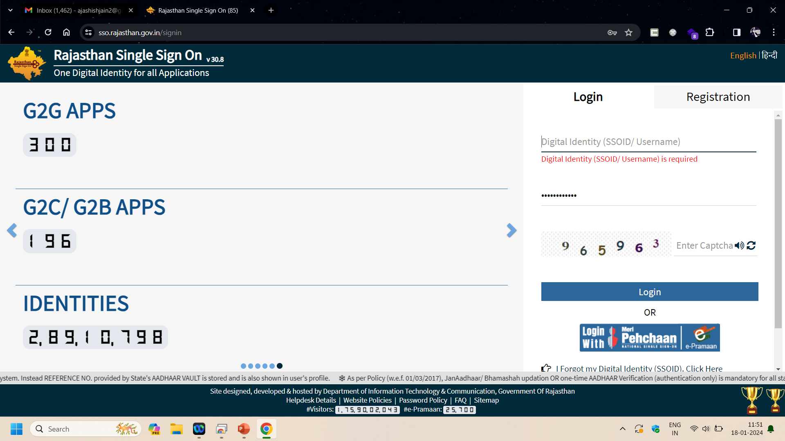
Instruct Student to visit sso.rajasthan.gov.in

Slide 3
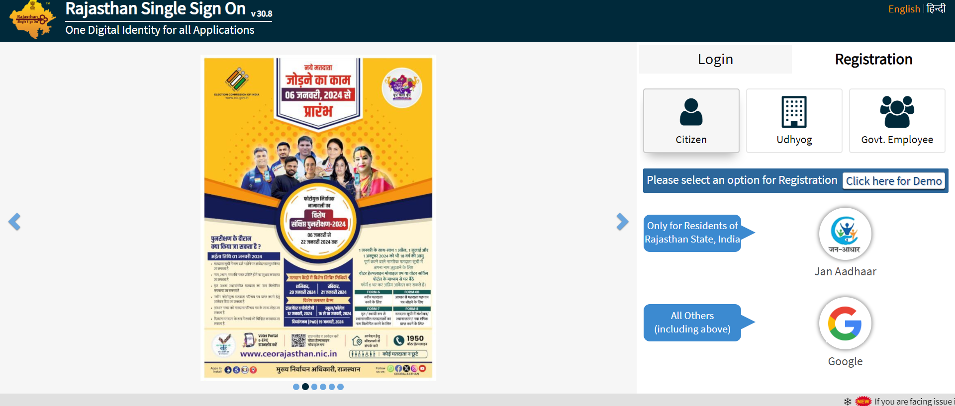
Instruct student to click Register on sso.rajasthan.gov.in and complete SSO Registration

Slide 4
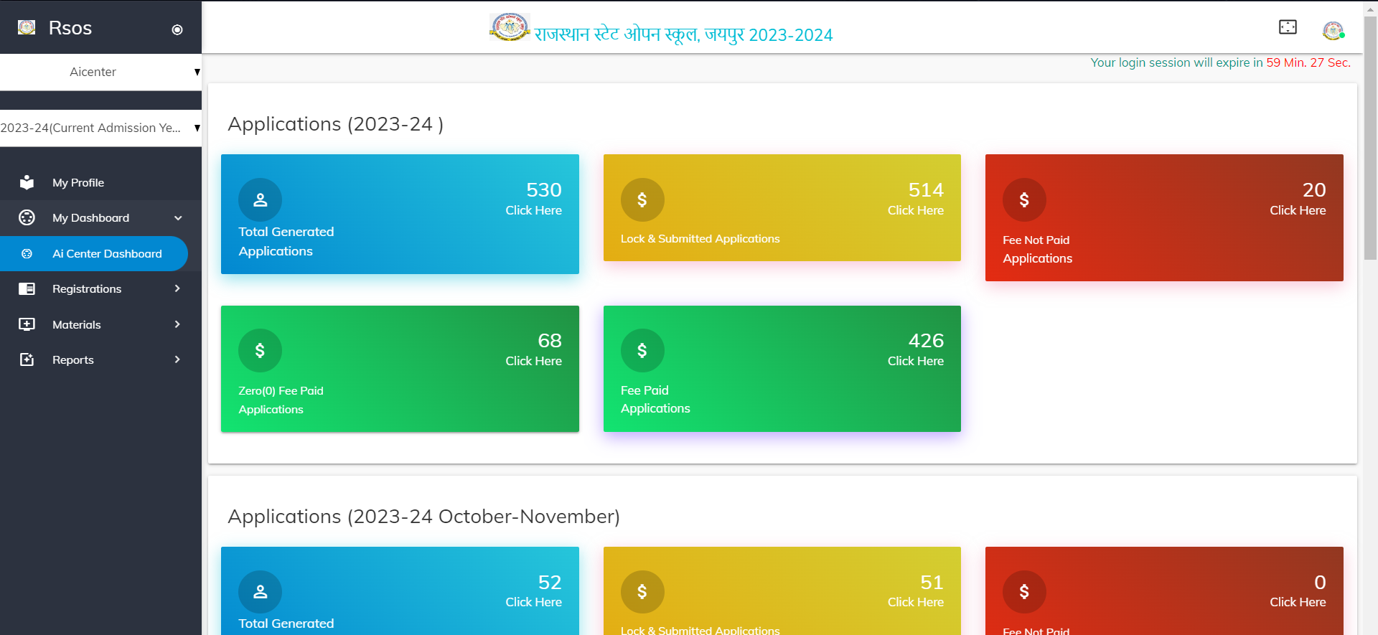
Once student registered on sso.rajasthan.gov.in, update the ssoid of the student in the RSOS portal by logging in using AI Center

Slide 5
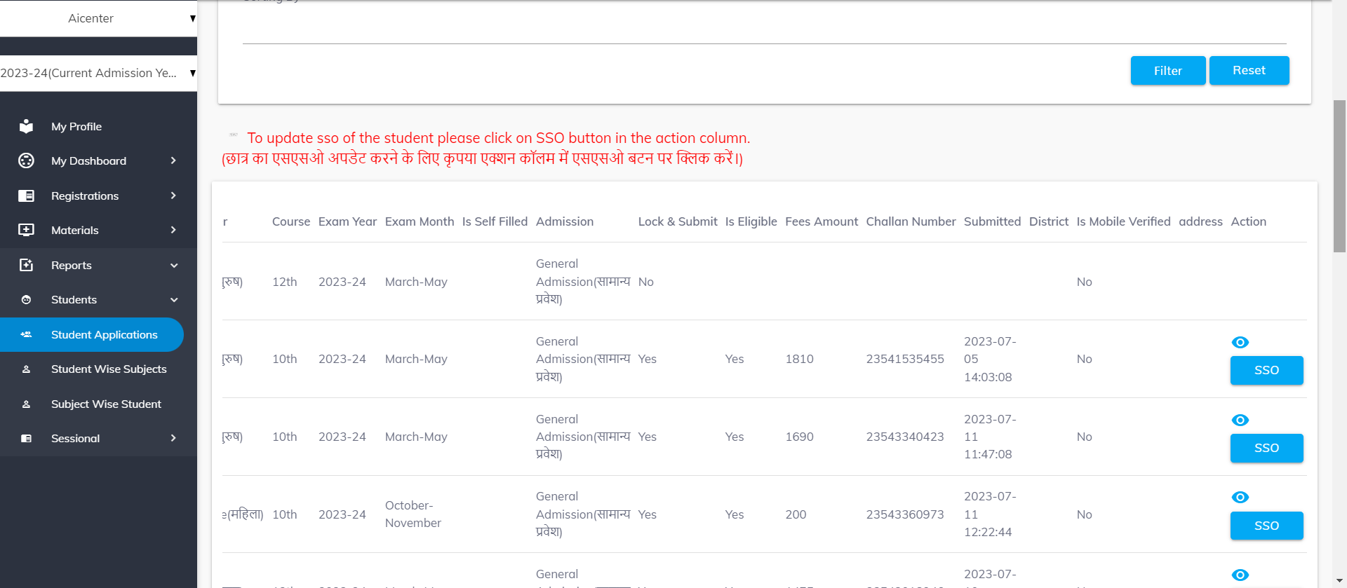
On clicking on Total Generated Application AI Center Nodal Officer will be able to see all the students and will get a option to update SSO

Slide 6
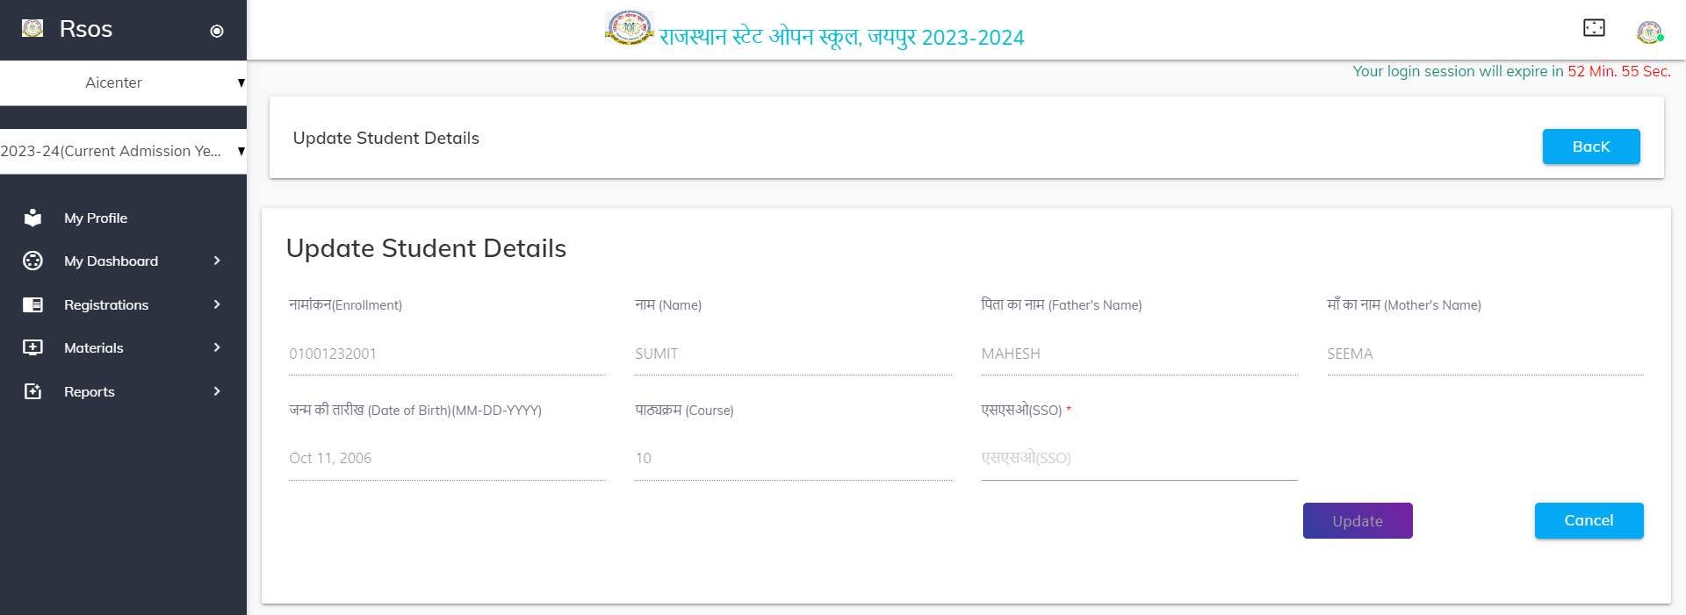
Enter the ssoid in the form and update the form

